Slide 1
Rolling out FHIR Architecture & Implementation Considerations
Lloyd McKenzie
FHIR Developer Days
November 26, 2014

Slide 2
This presentation
Can be downloaded here:
http://gforge.hl7.org/svn/fhir/trunk/presentations/2014-11 FHIR Dev Days/Architecture 2.pptx
(use “anonymous” and email address)
Is licensed for use under the Creative Commons, specifically:
Creative Commons Attribution 3.0 Unported License
(Do with it as you wish – just give credit)

Slide 3

Who am I?
Name: Lloyd McKenzie
Company: Gevity
Background:
One of FHIR’s 3 principle editors
Co-chair FHIR Management Group
Co-chair HL7 Modeling & Methodology
Chair HL7 Canada Architecture & Infrastructure
Heavily involved in HL7 and healthcare exchange for last 15 years (v2, v3, CDA, etc.)

Slide 4
Who are you?
Who is familiar with:
V2
V3
CDA
Background
Technical (e.g. developer, architect)
Clinical
Non-technical (e.g. manager, CEO)

Slide 5
Tutorial Objectives
In next 1.5 hours
FHIR’s interoperability paradigms (and where to use)
Where FHIR can fit in the architectural stack
FHIR architectural considerations and how to address them
If, when and how FHIR might be used within your own organization
Next steps
Notes:
We will skim the details – there will be webinars that will cover some of these topics in more detail

Slide 6
What Paradigm

Slide 7
Paradigms
FHIR supports 4 interoperability paradigms
REST
Documents
Messages
Services
What should you use when?
Notes:
Temperature check – how many people feel they’ve got a good handle on the paradigms and when they’d use them vs. not. (This isn’t really FHIR-specific)

Slide 8
REST
Simple, out-of-the-box interoperability
Leverage HTTP – protocol that drives the web
Pre-defined operations
Create, Read, Update, Delete
Also: History, Read Version, Search, Updates, Validate, Conformance & Batch
Rest
Notes:
Review

Slide 9
REST
Suited for
Not as good if
Out-of-the-box interoperability
Light-weight
CRUD-type operations
Client-server architectures
Client-driven orchestration
E.g. Mobile, PHR, Registries
Complex or server-driven orchestration
Unit of work != resource
No natural server

Slide 10
Documents
Similar to CDA
Collection of resources bound together
Sent as a “bundle” of resources
First resource is “Composition”
Just like CDA header
One context
Can be signed, authenticated, etc.
Documents

Slide 11
Documents
Suited for
Not as good if
Focus on persistence
No workflow
Need rules over rendering, what’s authenticated
Data spans resources
Need workflow
Data is dynamic
Need to manipulate resources independently

Slide 12
Messages
Similar to v2 and v3 messaging
Message is also a “bundle” of resources
Allows request/response behavior
bundles for both request and response
Event-driven
E.g. Send lab order, get back result
Can be asynchronous
Messages

Slide 13
Messaging
Suited for
Not as good if
Request/Response workflow
Need asynchronous
More complex behaviors than CRUD
CRUD operations on transports other than HTTP
There’s another standard way to do it
Notes:
E.g. Admit/Discharge/Transfer

Slide 14
Services
REST, Messaging and Documents are all “types” of services
“FHIR Services” means “everything else”
Only constraint is that you’re passing around FHIR resources in some shape or manner
Could be HTTP, but could be SOAP, email, etc.
Services
Notes:
Comment about SOA discovery day

Slide 15
Services
Suited for
Not as good if
Operations other than CRUD without messaging overhead
More complex workflow than request/response
Mix documents with behavior
Need tight control over data display
Want lightweight communications
Want to avoid pre-negotiation of behavior

Slide 16
Paradigm guidance
No absolutes
Guidance only
Influenced by preference, legacy
Not limited to only one
Mix and match to meet use-cases/communication partners

Slide 17
FHIR Architecture Approaches

Slide 18
Some possible uses
v3
App
v2
FHIR
PHR
FHIR
Broker
Comm.
Interface
FHIR
DB
Notes:
You’re a message broker routing and translating between v2, v3 and FHIR
Your app interfaces with a PHR using FHIR natively
Your application can communicate using FHIR, but your software uses a proprietary RDBMS
Use FHIR as the common language for a Vendor Neutral Archive
…Or a combination….
You might see data as a nested structure of XML, a series of tables with keys, class-diagrams….

Slide 19
Beyond exchange
v3
Other
v3
v2
Other
v2
Decision Support
Broker
FHIR
FHIR
Repository
FHIR
X12
Notes:
FHIR can be your shared persistence layer – nice granularity for storage, extensions for handling “extra” stuff easily
FHIR can be the common model for your mapping layer
FHIR can be the logical model used for decision support, both to expose your data to the decision support engine as well as to define rules (work in progress with vMR-CDS and CQI)

Slide 20
From wire to store
REST interface
JSON/XML
JSON/XML
JSON/XML
FHIR Parser
FHIR Parser
FHIR Parser
Fhir Service
POCO/POJO
POCO/POJO
POCO/POJO
O-R Map
Serialize
Serialize
Storage
NoSql (Xml/Json)
DBMS
DBMS
Notes:
First scenario is most common for existing databases: you have to map the FHIR structure (as POCO’s) onto your (existing) databases tables. Lot’s of mappings to support our nesting, cardinalities, data types
Second scenario uses the parsers to create POCO’s then use a NoSql driver’s serialization possibilities to store the structure-as-is in NoSql
Third scenario uses POCO’s and DBMS, but instead of mapping FHIR to tables, stores the data as-is into blob storage in a DBMS

Slide 21
Storage approaches
Map FHIR objects to a relational database
E.g. Hibernate
Store the JSON or XML directly in a NoSql data base
Store the JSON or XML as a blob and store index data in separate table
Notes:
Todo: Add example

Slide 22
Architectures
FHIR makes no assumptions about the architectural design of systems
You can use it for
Light or heavy clients
Central server or peer-to-peer sharing
Push or pull
Query or publish/subscribe
Loosely coupled or tightly coupled environments
With history tracking or without

Slide 23
Bottom Line
FHIR is a set of tools
Defined resources
Extensibility mechanism
Set of standard interfaces
Primary purpose is interoperable data exchange
However, it can be leveraged in many ways
Many we haven’t even thought of yet . . .

Slide 24
FHIR Features
And the architecture decisions that go with them
Notes:
10:00

Slide 25
FHIR Features
Narrative
Extensions
Modifier Extensions
Versions
Tags
Syntaxes
Signatures
Reference Libraries
Metadata
Bundles

Slide 26
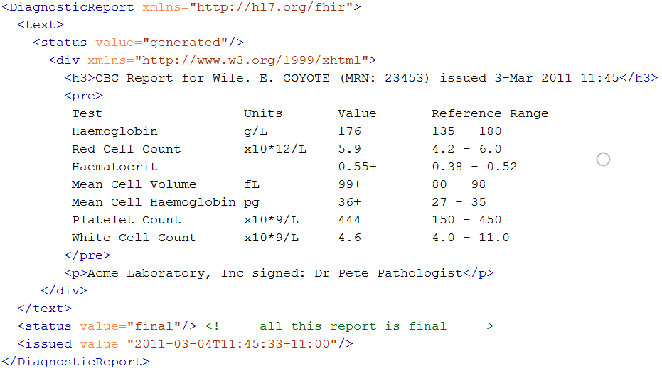
Narrative

Slide 27
Narrative
All resource instances SHOULD have it
Considerations
What should be in it?
How should it be formatted
Should it be generated, human entered or mix?
Should it be displayed to users? When?

Slide 28
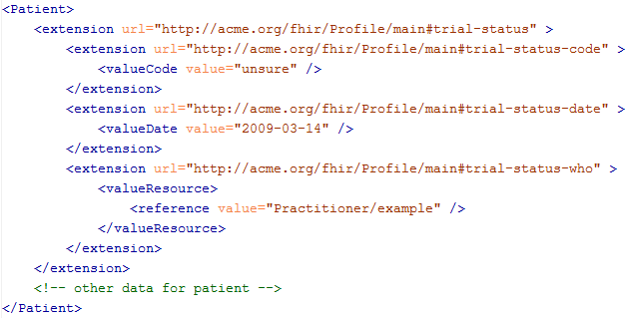
Extensions

Slide 29
Extensions
Extensions are normal
Consequence of “the 80%”
Can appear anywhere (even date, boolean)
Considerations
Will you store unrecognized extensions?
What if the data changes?
Will you display them?
What data will you expose as extensions? How?
Where will you register them?

Slide 30
Modifier Extensions
Change the meaning of other elements
E.g. negation, uncertainty
Considerations
What will you do if you receive one you don’t recognize?
Will you need to introduce any?

Slide 31
Versions
33, v12 – 2012-12-04
/server.org/fhir/Patient/33/_history/12
33, v13 – 2012-12-05
/server.org/fhir/Patient/33/_history/13
33, v14 – 2012-12-08
/server.org/fhir/Patient/33/_history/14
33, v15 – 2012-12-09
/server.org/fhir/Patient/33/_history/15
/server.org/fhir/Patient/33
Notes:
* Note that you have two ways (at one moment) to reach version 15

Slide 32
Versions
Metadata property of all instances
Considerations
Will your system support retrieving history?
Does your back-end have the ability to expose a version id or e-tag?

Slide 33
Tags
Patient
MRN 22234
“Ewout Kramer”
30-11-1972
Amsterdam
http://hl7.org/fhir/tag http://example.org/fhir/Status#Test
http://hl7.org/fhir/tag/profile http://hl7.org/fhir/Profile/us-core

Slide 34
Tags
Allow conveying data about a resource/bundle outside the resource/bundle
Workflow, profiles, access control
Considerations
What tags will you support
What will you convey with tags vs. extensions?

Slide 35
Syntaxes
Xml
JSON
<XXX xmlns=“urn:foo”>
<B a=“c” />
<C>One</C>
<C>Two</C>
<D>One</D>
<div>Not <b>so</b> easy</div>
</XXX>
{ “B”: { “a” : “c” },
“C”: [ “One”, “Two” ],
“D” : “One”,
“div” : {
“text-before”:“Not ”,
b:“so”,
“tekst-after”:“easy”}
}
Notes:
We tried to find a way to automatically convert between the two so you could round-trip…
But discovered you’d need additional metadata to do that, or vendor-specific solutions
Decided not to introduce these: result was weird Xml or weird Json
Reference platform contains tools to interconvert (these use model definition metadata)

Slide 36
Syntaxes
XML & JSON (and eventually RDF)
Custom conversion processes required
Handled by reference implementations
Considerations
What syntax(es) will you support?
Will you use the reference implementations or roll your own?

Slide 37
Interoperating with legacy
How do you make FHIR play nicely with v2, v3, CDA?
Not enough time to cover here
Look at
http://hl7.org/fhir/comparison.html
https://healthlevelseven.desk.com
(members only)

Slide 38
What now?
Notes:
10:00

Slide 39
Dealing with DSTU
FHIR is a “draft standard”
Anything can change – no compatibility promised
Changes driven by implementation feedback
Most changes expected in resources
Already significant implementation experience through reference implementations, connectathons
Some needed resources aren’t yet defined
Insurance, Referral, etc.
At least one more DSTU, possibly more before content becomes normative
What goes normative when will depend on degree of implementation

Slide 40
DSTU Strategies
If multiple DSTU versions could be in play
Distinguish using tags or distinct endpoints
Be prepared to transform between versions to move/rename elements or handle syntax changes
For missing resources
Use Other
Create your own custom resource
Non-conformant, but ok during DSTU in closed community

Slide 41
FHIR adoption approaches
Low hanging fruit
Registries
Terminology
MHD (XDS)
CCDA interface
Patient Portals / Mobile Health
Others?
Trial & Experiment
New to your organization
New to HL7 standards
Questionnaire
Concept Map
Deep Dive
Convert everything?

Slide 42

Estimating
How much will implementing a FHIR solution cost?
Considerations
Reference implementations help
Learning curve is lower
Still a curve if unfamiliar with XML / JSON / REST
Faster to “drive by” interoperability
Can’t speed consensus
Tools to help with mapping to internal codes and structures, still takes time
Anecdotal is “faster” to “significantly faster” to implement
Notes:
If I had a guaranteed answer, I’d be too busy to teach this course . . .

Slide 43
Time-points for re-evaluation
Dec 2014: Draft for Comment Ballot
Apr. 2015: DSTU 2 ballot
Summer 2015: DSTU 2 published
2017: First Normative specification
Additional releases every 12-18 months

Slide 44
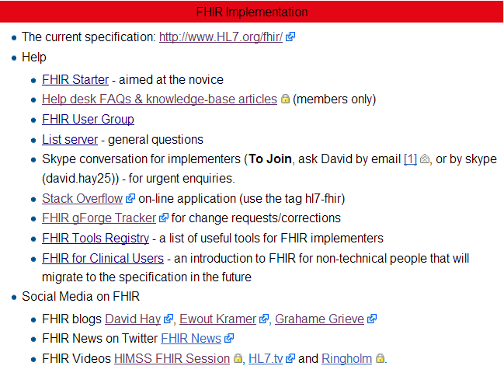
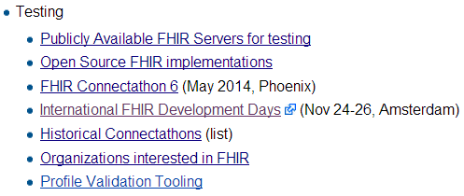
Resources wiki.hl7.org/?title=FHIR

Slide 45


Next Steps for you
Attend other FHIR tutorials
Developers, Profiles, Deep Dive
Read the spec: http://hl7.org/fhir
Comment in the discussion areas
Follow #FHIR on Twitter
Shape the specification:
Join the FHIR track at this WGM
Feedback – discussion, tracker, list server
Try implementing it
Come to a Connectathon!

Slide 46
Education opportunities
Attend a Working Group Meeting
Tutorials, Connectathons
Jan 16-23 San Antonio
May 8-14 Paris
Attend an Implementation Workshop
Intensive tutorials, hands-on
March 15-18 Pittsburgh?
FHIR Institute Webinars
Local education opportunities through affiliates, firms like Furore

Slide 47

Questions?
http://hl7.org/fhir lmckenzie@gevity.com

